Slide 1
AMAZON REKOGNITION
-What is it?
-Features
-Advantages
-Working
-Use cases
-demo

Slide 2

What is Amazon Rekognition
Amazon Rekognition is a tool that is easy to use, it helps us add image and video analysis to our applications and it doesn’t require any deep learning expertise to use it.

Slide 3
Features
1. Labels: It can identify various objects and label them accurately.
2.Custom Labels: We can create a model that is uniquely built for our usage
3. Content Moderation: It can identify any inappropriate content in the video or image.
4. Text Detection: it can identify any distorted letters.
5. Face Search: We can get data about the person in the picture.

Slide 4
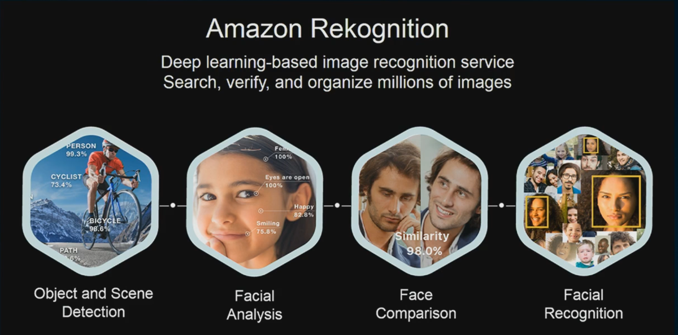
Advantages:
Advantages:
1. Very easy to integrate
2. Low cost(cost-effective)
3. Using of Artificial Intelligence

Slide 5
Working

Slide 6
Use Cases
1. Extracts Meta Data( created date, data modified, etc)
2. Identify any emergency situations like theft, fire, etc in public places
3. Identity verification (digital verification applications can be made)
4. Identify places, products, and brands.
Best application: If we want to identify the person who is missing, by using the Amazon Rekognition application we can build a model that can accurately identify that person in the large number of people. So many real-life problems can be solved by this AWS Rekognition.

Slide 7
Demo
Object detection demo.

